Slide 1
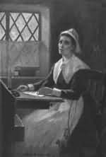
Anne Bradstreet
(1612-1672)
From a 19th C painting

Slide 2
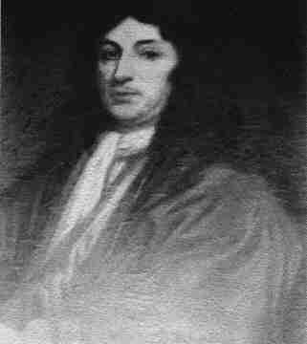
Biographical Background
Born Anne Dudley in England in 1612
Father Thomas Dudley
Extensive education
Thomas Dudley

Slide 3
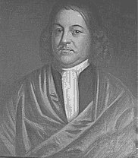
Married Simon Bradstreet at age 16
Simon would later become governor of the Massachusetts Bay Colony
Simon Bradstreet

Slide 4
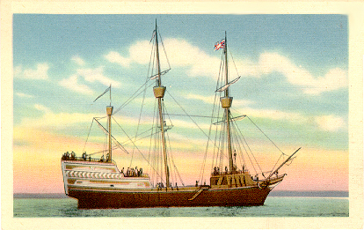
Dudleys and Bradstreets sailed to New World on the Arbella
Docked at Salem, Mass. July 22, 1630

Slide 5
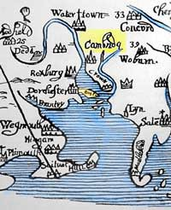
Bradstreet wrote that her “heart rose” in protest against the “new world and new manners.”
Thomas Dudley: “We found the Colony in a sad and unexpected condition, above eighty of them being dead the winter before; and many of those alive weak and sick; all the corn and bread amongst them all hardly sufficient to feed them a fortnight.”
Massachusetts Bay Colony

Slide 6
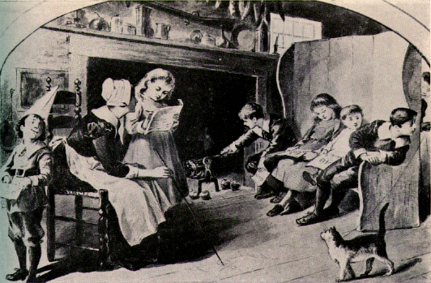
Gave birth to eight children between the years 1633 and 1652

Slide 7
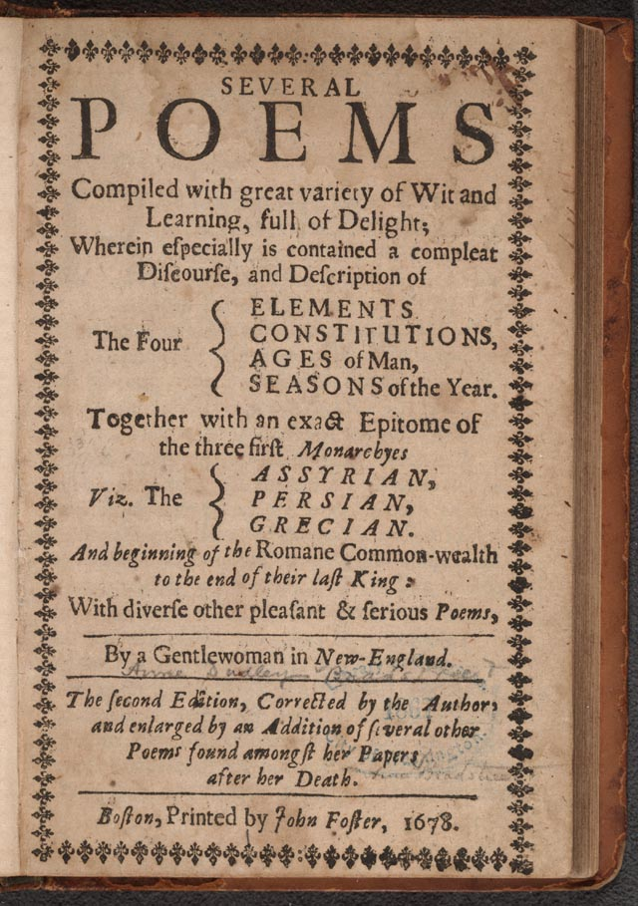
The Tenth Muse published in 1650 in London through efforts of John Woodbridge.
Later revised, published posthumously in 1678.

Slide 8
Critical Estimation
One of the best-selling volumes of poetry in 17th C London
19th C critic Charles Francis Richardson: “…a pitiful indication of the literary poverty of the days and land in which it was popular.”
Current: Early work too imitative. Second edition stronger, especially poems about her husband, family, religious ambivalence. A proto-feminist?

Slide 9
Personal Conflicts in Bradstreet’s Poetry
Between her desire to be an accomplished poet and the humility expected of Puritans
Between her desire to assert the worth and intelligence of women and the need to accept her traditional place as a woman in Puritan society

Slide 10
Humility, Role of Women
“The Author to Her Book”
“The Prologue”
“In Honor of that High and Mighty Princess Queen Elizabeth of Happy Memory”

Slide 11
Puritan Views of Intellectual Women
Governor John Winthrop, writing in 1645:
“Mr. Hopkins, the governor of Hartford upon Connecticut, came to Boston, and brought his wife with him, (a godly young woman, and of special parts,) who was fallen into a sad infirmity, the loss of her understanding and reason, which had been growing upon her divers years, by occasion of her giving herself wholly to reading and writing, and had written many books. Her husband, being very loving and tender of her, was loath to grieve her; but he saw his error, when he was too late. For if she had attended her household affairs, and such things as belong to women, and not gone out of her way and calling to meddle in such things as are proper for men, whose minds are stronger, etc., she had kept her wits, and might have improved them usefully and honorably in the place God had set her.

Slide 12
Personal Conflicts, Cont.
Between her sensory love of her husband, children, and possessions and a religious doctrine that taught she should be more focused on the rewards of heaven
Between religious doubt and faith

Slide 13
Love of Earthly Things/Religious Doubts
“To My Dear and Loving Husband”
“A Letter to Her Husband, Absent Upon Public Employment”
“In Memory of My Dear Grandchild Elizabeth Bradstreet”
“Here Follow Some Verses upon the Burning of Our House”

Slide 14
Religious Doubt, cont.
Letter, “To My Dear Children”:
Like Bradford, Winthrop, Rowlandson, etc. believed in God’s Providence: Illnesses, tragedies happen for a reason, to teach a lesson.
Yet, still has doubts: “Many times hath Satan troubled me concerning the verity of the Scriptures, many times by atheism how I could know whether there was a God; I never saw any miracles to confirm me, and those which I read of, how did I know but they were feigned?” (113).
Reassures herself in her faith: “That there is a God my reason would soon tell me by the wondrous works that I see, the vast frame of the heave and the earth, the order of all things, night and day, summer and winter, spring and autumn, the daily providing for this great household upon the earth, the preserving and directing of all to its proper end” (113).
“Yet why may not the Popish religion be the right?” (113).

